Slide 1

User-Friendly HR Data
By Karol, Chimdinma, Minh, and Tamara

Slide 2


Meet our end-user, Hannah who has limited coding knowledge.
Why Power BI is helpful to us and Hannah?
Visual
Allows interaction
Expertise

Slide 3
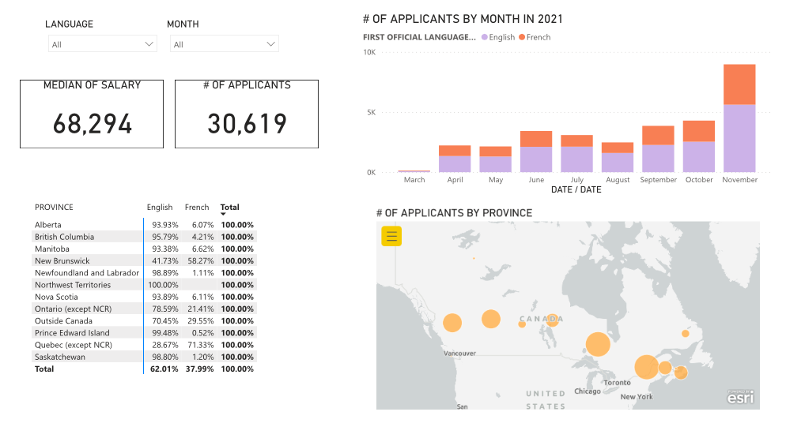
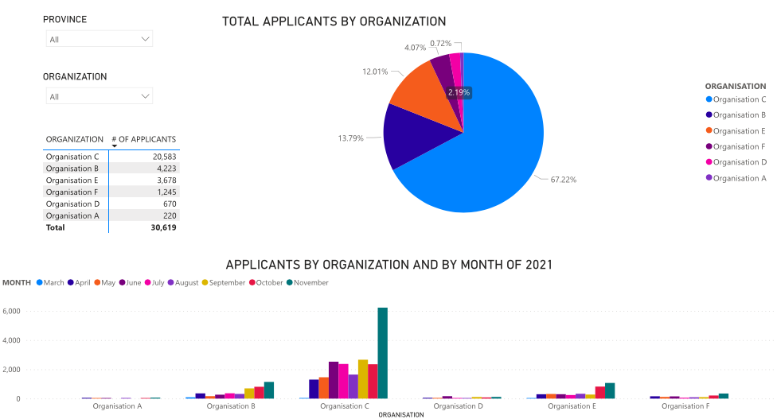
Solution
Website:
Username: CANDEV2022@Ontario254.onmicrosoft.com
Password: Hal90050

Slide 4
Challenges
Making the webpage public
Limited technical skills

Slide 5

Vision and future expansion

Slide 6
Main output
Hannah will be able to:
Interact through graphs, tables, maps, slicers and filters
Know:
How many applications are done?
Which are the higher salaries?
Equity groups applications
Share the report link within the organization
Export to excel, PDF and Powerpoint
Will be able to look at sensitive information(if given access)

